Slide 1
Flow-Control Statements
Dr. Ahmad Altarawneh

Slide 2
Outline
If statement
If-else statement
If-else-if ladder
For loop
range function
While loop
Nested loops

Slide 3
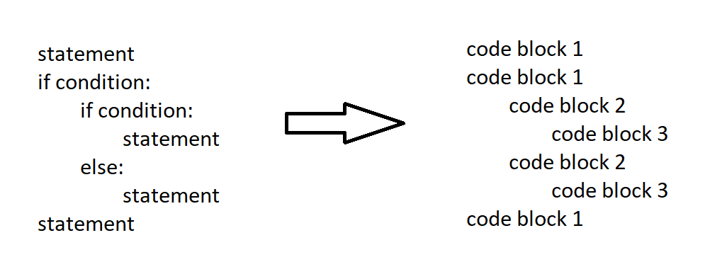
If statement
If statement in python, as any other programming language, is used to execute a block of code when a condition is true
Instead of {} python uses indentation to identify the block of code
it is used whenever you want to write a block of code
if condition:
# code to execute if condition is True

Slide 4
If-else
In the if statement, the block is executed when the condition is true
it does not do anything when it is false
If one wants to execute a different block of code when the condition is false, you should use if-else statement
age = 15
if age >= 18:
print("You are a grown man.")
else:
print("You are still a kid.")
if condition:
# code to execute if condition is True
else:
# code to execute if condition is False

Slide 5
If-else-if ladder
In more complex scenarios, when you have to check multiple conditions, if-else-if ladder is used
Python uses the short elif instead of else if
score = 85
if score >= 90:
grade = "A"
elif score >= 80:
grade = "B"
elif score >= 70:
grade = "C"
elif score >= 60:
grade = "D"
else:
grade = "F"
print(f"Your grade is: {grade}")
if condition1:
# code to execute if condition1 is True
elif condition2:
# code to execute if condition2 is True
elif condition3:
# code to execute if condition3 is True
...
else:
# code to execute if none of the conditions are True

Slide 6
Loops in Python

Slide 7
for loop
In general, loops are used to execute a block of code multiple times
it is used for iterating over a sequence (such as a list, tuple, string, dictionary, set, or range) or other sequential objects
For loop is used when the number of repetitions is known
For instance, you might want to add a number to every element in a list, you can use for loops
for variable in sequence:
# code to execute for each item

Slide 8
Lists
We will come to lists with more details, later
We will talk for a little about lists here to demonstrate loops
A python list is a collection (sequence) of elements of any type
Remember everything in python is an object
A list can be defined as any other variable, must have a name
The value(s) are passed inside squared brackets
lst1 = [1, 2, 3, 4]
lst2 = ['Ahmad', 'Maher', 'Sami', 'Rami']
lst3 = [1, 'Name', 2.5, 1+0j]
lst4 = [] #Empty list

Slide 9
Loop over a list
For loop helps in visiting every element in the list
For example:
the variable i changes with the loop iteration
for i in lst1:
print(i+20)
for i in lst1: #lst1 = [20,0,4,6]
print(i)
40
20
24
26
20
0
4
6

Slide 10
range()
range function makes it easy to generate a series of numbers
Syntax
Examples:
Pass these to the list() function and observe the output
range (stop)
range (start, stop)
range (start, stop, step)
range(2,6)
range(4,10,2)
list(range(7))
list(range(20,10,-2))
[0, 1, 2, 3, 4, 5, 6]
[20, 18, 16, 14, 12]
Note: The last element (stop) is not included

Slide 11
Cont.
-1
0
1
2
for number in range(4):
print(number-1)
Use the range function to check the numbers from 10 to 20. if the number is odd, print the number and the word "is odd"
Not necessary to use the variable inside the loop
it is used to specify the number of iterations
for number in range(10,20):
if number % 2 != 0:
print(f"The number {number} is odd")
for number in range(3):
print('Hello guys!')

Slide 12
While loop
While loop is used when the number of iterations is not defined
When the iterations number depends upon condition
The loop continues as long as the condition is True.
You need to manage the loop variable and update it inside the loop, if applicable. Failure to do so can lead to infinite loops.
Typically used when the number of iterations is unknown or based on a specific behavior.
Draw a box on the screen, around a human face, as long as there is a face on the screen
while condition:
# code to execute while condition is True

Slide 13

Example
Write a code of a program that receives an integer value. if the integer value is greater than 10 ask the user to enter another number. If the number is less than or equal to 10 it exits the program and prints "bye".
input is used to receive a value from the user
integer = input("Enter an integer number ")
while int(integer) > 10:
integer = input("Enter another integer number ")
print("Bye!")
integer = input("Enter an integer number ")

Slide 14
While-else
The while loop can be paired with an else clause
this feature is somewhat unique to Python
Example:
Imagine you have a list of numbers, and you want to check if a number exists in the list.
If the number is found, you'll stop the search and print its index.
If the number isn't found after checking the entire list, you'll print a message saying it's not in the list.
while condition:
# Code to execute while the condition is True
else:
# Code to execute after the loop ends, but only if the loop didn't encounter a 'break'

Slide 15
Cont.
numbers = [1, 3, 5, 7, 9, 11, 13]
search_for = 5
index = 0
while index < len(numbers): #len gives the length of the list(number of items)
if numbers[index] == search_for:
print(f"Found {search_for} at index {index}.")
break
index += 1
else:
print(f"{search_for} not found in the list.")

Slide 16
Jump statements

Slide 17
Break
The break statement is used to terminate the loop prematurely, skipping the rest of its body.
It's most commonly used inside for and while loops
Often accompanied by a conditional if statement.
while True:
integer = input("Enter an integer number")
if int(integer) <= 10:
print("Bye!")
break

Slide 18
Continue
The continue statement skips the current iteration of the loop and jumps to the next iteration.
Like break, it's used inside loops
Often accompanied by a conditional if statement
for i in range(5):
if i == 3:
continue
print(i)
0
1
2
4

Slide 19
Pass
The pass is a no-operation statement.
It's a placeholder where some code is required, but you don't want any action to be taken.
It's often placed to keep the code syntax correct while intending to complete it later on.
for i in range(5):
if i == 3:
for i in range(5):
if i == 3:
pass
Executes fine
SyntaxError: incomplete input

Slide 20
Nested loops
Nested loops are useful in many cases, including:
Processing Multi-dimensional Data Structures:
When dealing with matrices, grids, or any 2D (or higher-dimensional) data structure, nested loops are often necessary.
Example: Matrix multiplication, reading images, and values in a 2D grid.
Examples:
looping over folder contains subfolders and files in each subfolder
Find pairs of values in two lists
for outer_variable in outer_sequence:
# Outer loop code (optional)
for inner_variable in inner_sequence:
# Inner loop code
# More outer loop code (optional)

Slide 21
Example
Multiplication table: create the multiplication table from 1 to 4
find and print all possible pairs of the elements in these two lists [1, 3, 5, 6] and [10, 5, 2, 4]
for i in range(1, 4):
for j in range(1, 4):
print(f"{i} x {j} = {i*j}")
print("-----")

Slide 22
Exercise
Scenario: Let's consider we have the following list of product prices.
We want to:
Calculate the average price.
Count the number of products that are priced above the average.
If the majority of products are priced above the average, then we'll discount all product prices by 10%.
If not, we increase all prices by 5%.
Finally, print the new product prices.
product_prices = [85, 78, 92, 89, 73]

Slide 23
Student scores
Assume that you have the following lists
one contains the name of students
And one contains marks
Calculate the average marks for each one of the students
Compare the averages and print the name of the student that has the largest average, and print his name and average formatted using the f modifier
Names = ["Kenan", "Karam", "Karam", "Karam", "Karam", "Kenan", "Kenan"]
Marks = ["50", "80", "80", "75", "90", "70", "65"]

